Slide 1
Step1:
Input: raw cohort and label data
Merge and Filter by dates (new bioinformatics)
Input: individual sample data files
Attach sample_id to taxa data
Output: combined cohort data
Output: combined sample taxa data
Step2:
Input: combined cohort data
input: combined sample taxa data
Merge chort and sample data
compute middle taxa counts quartiles for all, pet, nopet
Output: combined cohort and sample data
Output: 3x middle quartile (all, nopet, pet)
Step3:
Input: combined cohort and sample data
Input: 3x middle quartile (all, nopet, pet)
Compute 3 scores for each sample (see slide 3)
(More tbd)
Output: scores table (see slide 4)

Slide 2
sample
Genus summary
sample
Filtered genus
sample

Slide 3
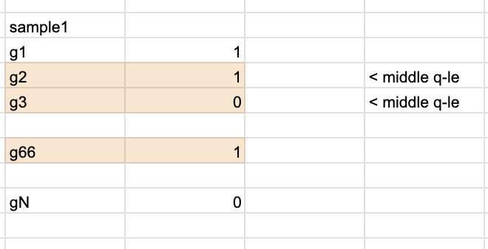
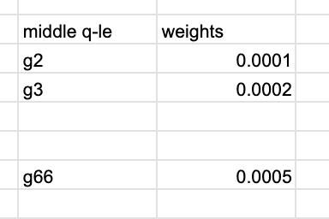
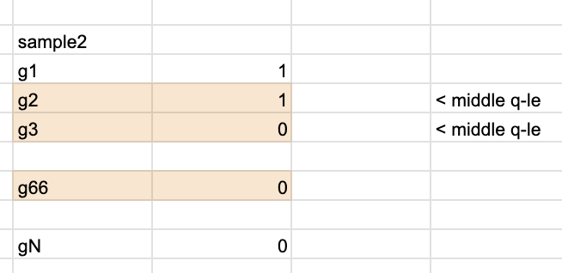
fun_score(big_df, external_id, m_qle):
Pull external_id data from big_df
Merge with m_qlw on tname
# now you have data only with m_qle tnames # plus: now you have the weights per sample
Sum up the weights for the sample
Implementation:
Extract all unique external_id
For each external_id call fun_score(external_id, m_qle)
Versions of this would be:
Plug in global m_qle
Plug in m_qle based on pet/nopet for each sample
M_qle = Nx2 (tname + weight)
Sample_i_mqle = sample_i[filter = only tname in m_qle]
Score_per_sample = sum(all M_qle.weight for tname in Sample_i)

Slide 4
Plug in m_qle based on pet/nopet for each sample
sample | pet/nopet | score_global based on m_qle global | score_pet based on m_qle pet | score_nopet based on m_qle nopet
1A2434343 | Yes | 0.06 | 0.09 | 0.05
1B4343234 | No | 0.055 | 0.053 | 0.07
1C4r343434 | Yes | 0.056 | 0.059 | 0.039
…

Slide 5
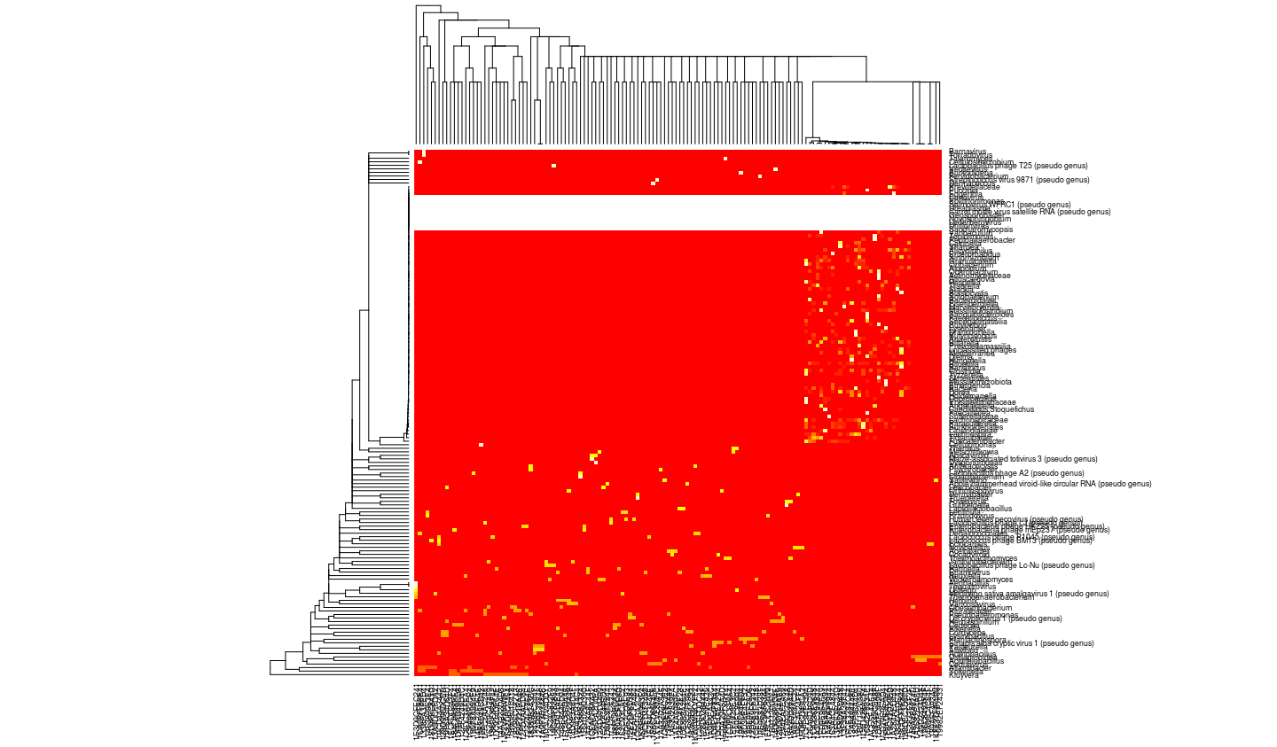

Slide 6
